Slide 1
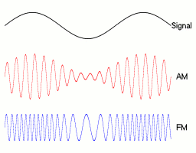

Analog and Digital Communication (ADC)
By Praveen Pawar
IIIT Bhopal
Last Updated: 2/28/2021 10:41 AM

Slide 2
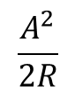
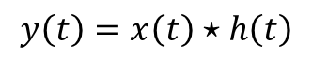
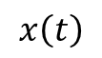
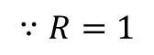
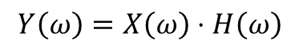
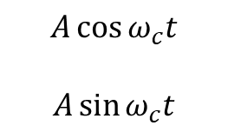
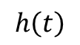
Preliminaries
$$A\cos{ω_{c}t}$$
$$A\sin{ω_{c}t}$$
Power
$$\frac{A^{2}}{2R}$$
$$∵R=1$$
Convolution
LTI System
$$x\left(t\right)$$
$$y\left(t\right)=x\left(t\right)⋆h\left(t\right)$$
$$h\left(t\right)$$
$$Y\left(ω\right)=X\left(ω\right)⋅H\left(ω\right)$$
Convolution in time domain is equal to multiplication in frequency domain

Slide 3
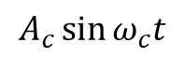
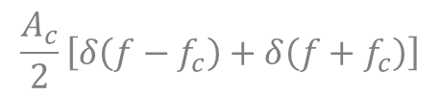
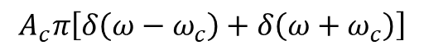
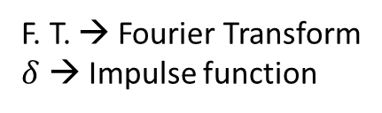
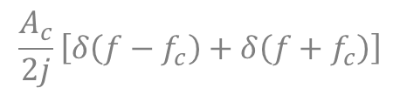
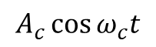
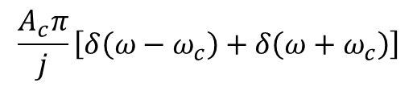
Preliminaries (continue…)
$$A_{c}\cos{ω_{c}t}$$
F. T.
$$A_{c}π\left[δ\left(ω−ω_{c}\right)+δ\left(ω+ω_{c}\right)\right]$$
F. T.
$$\frac{A_{c}}{2}\left[δ\left(f−f_{c}\right)+δ\left(f+f_{c}\right)\right]$$
F. T. → Fourier Transform
$δ$ → Impulse function
$$A_{c}\sin{ω_{c}t}$$
F. T.
$$\frac{A_{c}π}{j}\left[δ\left(ω−ω_{c}\right)+δ\left(ω+ω_{c}\right)\right]$$
F. T.
$$\frac{A_{c}}{2j}\left[δ\left(f−f_{c}\right)+δ\left(f+f_{c}\right)\right]$$

Slide 4
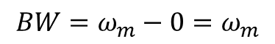
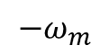
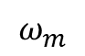
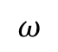
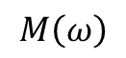
Preliminaries (continue…)
Baseband Signal:
A baseband signal represents a low frequency signal having its lower cutoff frequency either zero or very close to zero.
$$M\left(ω\right)$$
Bandwidth,
$$BW=ω_{m}−0=ω_{m}$$
$${−ω}_{m}$$
$$ω_{m}$$
$$ω$$
0

Slide 5
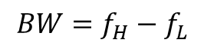
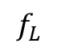
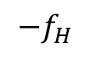
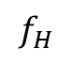
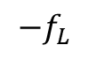
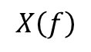
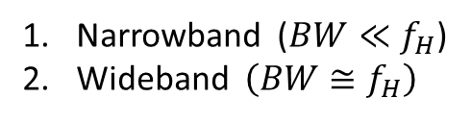
Preliminaries (continue…)
Bandpass Signal:
A bandpass signal represents a high frequency signal having its lower cutoff frequency very-very greater than zero.
$$X\left(f\right)$$
Bandwidth,
$$BW=f_{H}−f_{L}$$
= higher cutoff frequency
– lower cutoff frequency
$$ω$$
$${−f}_{H}$$
$${−f}_{L}$$
0
$$f_{L}$$
$$f_{H}$$
Depending upon the relation between bandwidth and higher cutoff frequency, there are two types of bandpass signals.
Narrowband ($BW≪f_{H}$)
Wideband $\left(BW≅f_{H}\right)$
Where $f_{H}$ is the higher cut-off frequency of the message signal.

Slide 6
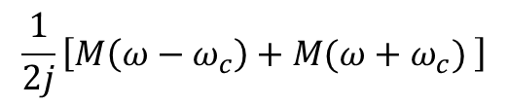
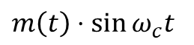
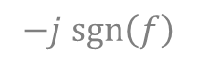
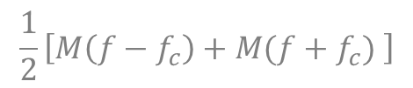
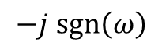
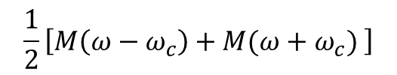
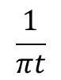
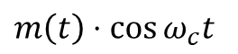
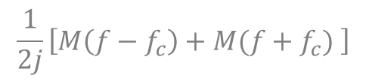
Modulation Theorem (Fourier Transform)
F. T.
$$\frac{1}{2}\left[M\left(ω−ω_{c}\right)+M(ω+ω_{c}) \right]$$
$m\left(t\right)⋅\cos{ω_{c}t}$
F. T.
$$\frac{1}{2}\left[M\left(f−f_{c}\right)+M(f+f_{c}) \right]$$
F. T.
$$\frac{1}{2j}\left[M\left(ω−ω_{c}\right)+M(ω+ω_{c}) \right]$$
$m\left(t\right)⋅\sin{ω_{c}t}$
F. T.
$$\frac{1}{2j}\left[M\left(f−f_{c}\right)+M(f+f_{c}) \right]$$
Hilbert Transform
$$\frac{1}{πt}$$
F. T.
$$−j sgn\left(ω\right)$$
F. T.
$$−j sgn\left(f\right)$$

Slide 7
Communication
Communication is the basic process of exchanging information.
A communication system essentially consist of three basic building blocks.
Transmitter
Channel
Receiver
Transmitter: - It is a physical system which transmits the information.
Receiver: - It is a physical system which receives the information.
Channel: - Channel is the medium through which information exchange takes place.
Depending upon type of channel used for information exchange, there are two types of communication:
1. Wireless Communication 2. Line or Wire Communication

Slide 8
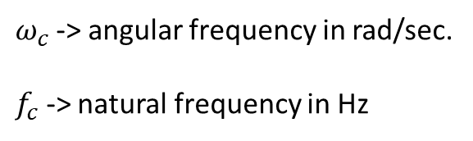
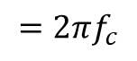
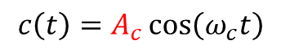
Modulation
Modulation is the process of superimposing the information content of a baseband modulating signal on a high frequency carrier signal by altering its characteristics (Amplitude, Frequency, and Phase).
$$c\left(t\right)=A_{c}\cos\left(ω_{c}t\right)$$
$ω_{c}$-> angular frequency in rad/sec.
$f_{c}$ -> natural frequency in Hz
$$=2πf_{c}$$
Amplitude
Phase
Modulation process transmits low frequency baseband signal into a high frequency bandpass signal.

Slide 9
Need for Modulation
Avoids mixing of the signals
Allows multiplexing of the signals
Reduces height of the antenna
Increases range of communication
Increases quality of reception

Slide 10
Amplitude Modulation (AM)
In time domain
In amplitude modulation, the amplitude of high frequency carrier signal is varied in accordance with the instantaneous value of the baseband modulating signal keeping frequency and phase constant.
In frequency domain
In amplitude modulation, the low frequency baseband signal is translated into high frequency bandpass signal.

Slide 11
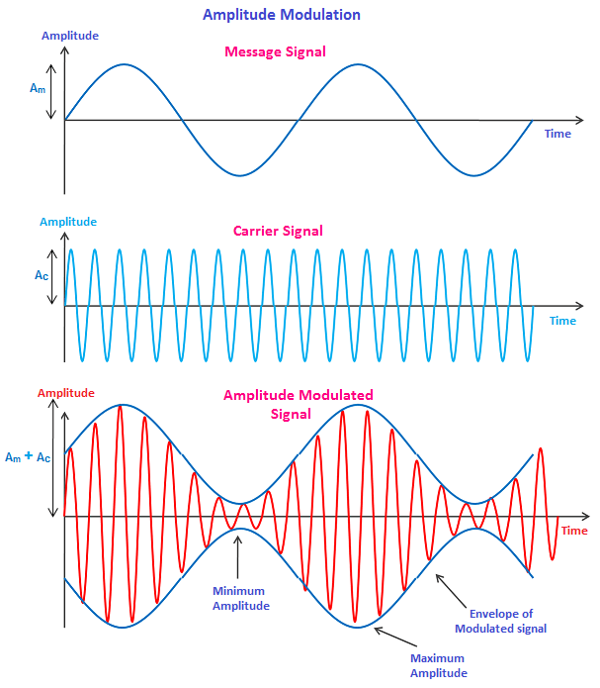

Slide 12
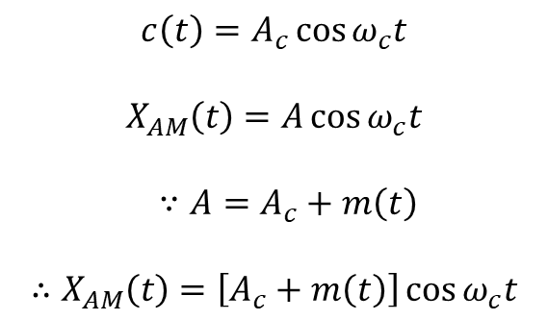
Equation for AM
Let, $m\left(t\right)=$ arbitrary modulating signal with maximum frequency $ω_{m}$
$$c\left(t\right)=A_{c}\cos{ω_{c}t}$$
$$X_{AM}\left(t\right)=A\cos{ω_{c}t}$$
$∵A=A_{c}+m\left(t\right)$
$$∴X_{AM}\left(t\right)=\left[A_{c}+m\left(t\right)\right]\cos{ω_{c}t}$$
$$X_{AM}\left(t\right)=A_{c}\cos{ω_{c}t+}m\left(t\right)\cos{ω_{c}t}$$
Carrier
signal
Message
signal

Slide 13
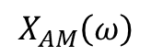
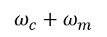
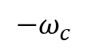
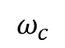
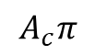
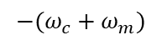
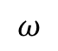
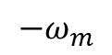
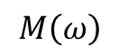




AM: Frequency domain representation
$$X_{AM}\left(ω\right)=A_{c}π\left[δ\left(ω−ω_{c}\right)+δ\left(ω+ω_{c}\right)\right]+\frac{1}{2}\left[M\left(ω−ω_{c}\right)+M\left(ω+ω_{c}\right)\right]$$
$$M\left(ω\right)$$
1
$${−ω}_{m}$$
$$ω_{m}$$
$$ω$$
0
$$X_{AM}\left(ω\right)$$
$$A_{c}π$$
LSB = Lower Side Band
USB = Upper Side Band
LSB
USB
½
$${−ω}_{c}$$
$$ω_{c}$$
$$ω$$
$${−(ω}_{c}+ω_{m})$$
$${−(ω}_{c}−ω_{m})$$
0
$$ω_{c}−ω_{m}$$
$$ω_{c}+ω_{m}$$

Slide 14

The AM signal contain three components, i.e., carrier signal, upper sideband (USB), and lower sideband (LSB).
The information is contained simultaneously in USB as well as LSB. The carrier does not contain any information.
The transmission bandwidth of AM signal is twice the maximum modulating signal frequency, i.e.,
Since BW is very very small as compare to higher cut-off frequency so the AM signal is a high frequency narrowband signal.
$$BW=ω_{c}+ω_{m}−\left(ω_{c}−ω_{m}\right)$$
$=2ω_{m}$ rad/sec
$=2f_{m}$ Hz

Slide 15



For sinusoidal AM,
$$m\left(t\right)=A_{m}\cos{ω_{m}t}$$
$$c\left(t\right)=A_{c}\cos{ω_{c}t}$$
$$X_{AM}\left(t\right)=A\cos{ω_{c}t}$$
where $A=A_{c}+A_{m}\cos{ω_{m}t}$
$$X_{AM}\left(t\right)=\left[A_{c}+A_{m}\cos{ω_{m}t}\right]\cos{ω_{c}t}$$
$$X_{AM}\left(t\right)=A_{c}\left[1+\frac{A_{m}}{A_{c}} \cos{ω_{m}t}\right]\cos{ω_{c}t}$$
Modulation Index $\left(m\right)=\frac{A_{m}}{A_{c}}$
$$X_{AM}\left(t\right)=A_{c}\cos{ω_{c}t+mA_{c}\cos{ω_{c}t}⋅\cos{ω_{m}t}}$$
$$X_{AM}\left(t\right)=A_{c}\cos{ω_{c}t+\frac{mA_{c}}{2}\cos\left(ω_{c}+ω_{m}\right)t+}\frac{mA_{c}}{2}\cos\left(ω_{c}−ω_{m}\right)t$$
Carrier
Signal
USB
LSB

Slide 16











Frequency domain representation:-
$$X_{AM}\left(ω\right)=A_{c}π\left[δ\left(ω−ω_{c}\right)+δ\left(ω+ω_{c}\right)\right]$$
$+\frac{{mA}_{c}π}{2}\left[δ\left(ω−{(ω}_{c}+ω_{m})\right)+δ\left(ω+{(ω}_{c}+ω_{m})\right)\right]$
$+\frac{{mA}_{c}π}{2}\left[δ\left(ω−{(ω}_{c}−ω_{m})\right)+δ\left(ω+{(ω}_{c}−ω_{m})\right)\right]$
$$X_{AM}\left(ω\right)$$
$$A_{c}π$$
$$\frac{mA_{c}}{2}π$$
$${−ω}_{c}$$
$$ω_{c}−ω_{m}$$
$$ω_{c}$$
$$ω_{c}+ω_{m}$$
$$ω$$
$${−(ω}_{c}+ω_{m})$$
$${−(ω}_{c}−ω_{m})$$
0

Slide 17




Power relation in AM
$$P_{t}=\frac{A_{c}^{2}}{2}+\frac{m^{2}A_{c}^{2}}{8}+\frac{m^{2}A_{c}^{2}}{8}$$
$$P_{t}=\frac{A_{c}^{2}}{2}+\frac{m^{2}A_{c}^{2}}{4}$$
$$∵P_{c}=\frac{A_{c}^{2}}{2}$$
Carrier power
$$P_{SB}=\frac{m^{2}A_{c}^{2}}{4}=\frac{m^{2}}{2}⋅\frac{A_{c}^{2}}{2}=\frac{m^{2}}{2}⋅P_{c}$$
SideBand power
$$P_{t}=P_{c}\left(1+\frac{m^{2}}{2}\right)$$

Slide 18





Transmission Efficiency (or Modulation Efficiency)
It is defined as the ratio of the useful power to the total transmitted power.
Gives the percentage of useful power and the total transmitted power.
$$η=\frac{useful power}{Total transmitted power}×100\%$$
Total power, $P_{t}=P_{c}+P_{c}⋅\frac{m^{2}}{2}$
$$η=\frac{P_{c}⋅\frac{m^{2}}{2}}{P_{c}+P_{c}⋅\frac{m^{2}}{2}}=\frac{P_{c}⋅\frac{m^{2}}{2}}{P_{c}\left(1+\frac{m^{2}}{2}\right)}×100\%$$
$$useful power$$
$$η=\frac{m^{2}}{2+m^{2}}×100\%$$

Slide 19
Time domain representation of AM signal

Slide 27
Vestigial Sideband Modulation (VSB)
SSB-SC modulation is well suited for transmission of voice because of frequency gap that exist in the spectrum of voice signal zero and a few hundred Hz. When the baseband signal contains significant components at extremely low frequencies as in case of T.V. picture signal, the upper and lower side band need at carrier frequency. This means that use of SSB modulation is inappropriate for transmission of such baseband signals due to difficulty of isolating one side band.

Slide 28
VSB
v(f)
V(f)
Modulation
f
f
- 3300 Hz
- 300 Hz
300 Hz
3300 Hz
f_{c}-3300 Hz
f_{c}-300 Hz
f_{c}
f_{c}+300 Hz
f_{c}+3300 Hz
p(f)
P(f)
Modulation
f
- 4.5 MHz
4.5 MHz
f_{c}- 4.5 MHz
f_{c}
f_{c}+4.5 MHz

Slide 29



















VSB
m($ω$)
M($ω$)
Modulation
$$ω$$
$$ω$$
$${−ω}_{m}$$
$$ω_{m}$$
$${ω_{c}−ω}_{m}$$
$${−ω}_{v}$$
$$ω_{c}$$
$$ω_{v}$$
$${ω_{c}+ω}_{m}$$
In VSB Modulation, one sideband is passed almost completely where as just a trace or vestige of unwanted sideband retains.
Specifically the vestige part of unwanted sideband components for the part removed from desired sideband.
M($ω$)
BW = $ω_{m}+ω_{v}$
$$ω$$
$${ω_{c}−ω}_{m}$$
$$ω_{c}$$
$${ω_{c}+ω}_{m}$$
$${ω_{c}−ω}_{v}$$
$${ω_{c}+ω}_{v}$$

Slide 30










VSB
$$m\left(t\right)$$
$$x\left(t\right)$$
VSB Filter
$$s\left(t\right)$$
$$h\left(t\right)$$
$$c\left(t\right)=cos ω_{c}t$$
Transmitter Side
$$s\left(t\right)$$
$$y_{1}\left(t\right)$$
Low Pass Filter
$$ω_{c}=ω_{m}$$
$$y\left(t\right)$$
$$cos ω_{c}t$$
Receiver Side

Slide 31

VSB
$$x\left(t\right)=m\left(t\right)⋅\cos{ω_{c}t}$$
$$s\left(t\right)=\left[m\left(t\right)⋅\cos{ω_{c}t }\right]∗h\left(t\right)$$
$$S\left(ω\right)=\frac{1}{2}\left[M\left(ω−ω_{c}\right)+M\left(ω+ω_{c}\right)\right]⋅H(ω)$$
$$∵y_{1}\left(t\right)=s\left(t\right)⋅\cos{ω_{c}t}$$
$$Y_{1}\left(ω\right)=\frac{1}{2}\left[S\left(ω−ω_{c}\right)+S(ω+ω_{c})\right]$$
$$Y_{1}\left(ω\right)=\frac{1}{4}\left[\left\{M\left(ω−ω_{c}−ω_{c}\right)+M\left(ω−ω_{c}+ω_{c}\right)\right\}⋅H\left(ω−ω_{c}\right)+\{M\left(ω+ω_{c}−ω_{c}\right)+M\left(ω+ω_{c}+ω_{c}\right)\}⋅H(ω+ω_{c})\right]$$
$$Y\left(ω\right)=\frac{1}{4}M\left(ω\right)\left[H\left(ω−ω_{c}\right)+H\left(ω+ω_{c}\right)\right]; −ω_{m}≤ω≤ω_{m}$$

Slide 33



This envelope detector consists of a diode and low pass filter. Here, the diode is the main detecting element. Hence, the envelope detector is also called as the diode detector. The low pass filter contains a parallel combination of the resistor and the capacitor.
$$\frac{1}{f_{c}}≪RC≪\frac{1}{f_{m}}$$

Slide 34
AM Receiver
Date: 28-01-2020
Functions of Receivers
To collect the electromagnetic waves transmitted by the transmitter.
To select the desired signal and reject all others. This is known as selectivity of the receiver.
To amplify the selected modulated signal. This is known as sensitivity of the receiver.
To detect the baseband modulating signal from the modulated Radio Frequency (RF) signal.
To amplify the baseband signal so as to operate loudspeaker.

Slide 35
Definitions
Selectivity :
The ability of receiver to distinguish between two adjacent carrier frequencies.
Sensitivity:
The ability of receiver to detect the weakest possible signal.
Fidelity:
The ability of receiver to reproduce faithfully all frequency components of the baseband signal.
Notes:
https://www.ques10.com/p/11434/explain-the-following-with-reference-to-radio-rece/

Slide 36




Tuned Radio Frequency (TRF) Receiver
Antenna
$$f_{S}$$
RF Amplifier
Demodulator
AF Amplifier
LS
AM: 535 – 1605 KHz
$f_{s}=1000$ KHz (consider)
$BW=10$ KHz (for 5 KHz message signal)
$$Q=\frac{1000}{10}=100$$
RF: Radio Frequency
AF: Audio Frequency
LS: Loud-Speaker
$f_{S}$ : Signal Frequency
Quality Factor,
$Q=\frac{Center Frequency}{Bandwidth}=\frac{f_{S}}{BW}$
If $f_{S}=1600$ KHz, to maintain the $Q$ value, required $BW$ is 16 KHz

Slide 37






Superheterodyne Receiver
Mixer
$$f_{S}$$
$${2f}_{S}+f_{IF}$$
OR
$$f_{IF}$$
$$f_{LO}=f_{S}+f_{IF}$$
Antenna
$$f_{IF}$$
$$f_{S}$$
RF Amplifier
Mixer
IF Amplifier
Detector/ Demodulator
AF Amplifier
LS
$$f_{LO}=f_{S}+f_{IF}$$
Local Oscillator
RF: Radio Frequency
IF: Intermediate Frequency
AF: Audio Frequency
LS: Loud-Speaker
$f_{S}$ : Signal Frequency
$f_{LO}$ : Local-Oscillator Frequency
Ganged Tuning

Slide 38


Superheterodyne Receiver
$f∝\frac{1}{\sqrt{C}}$
$f_{max}=\frac{1}{\sqrt{C_{min}}}$
$f_{min}=\frac{1}{\sqrt{C_{max}}}$
$\frac{f_{max}}{f_{min}}=\sqrt{\frac{C_{max}}{C_{min}}}$
$\frac{C_{max}}{C_{min}}={\left(\frac{f_{max}}{f_{min}}\right)}^{2}$
$f_{LO}=\frac{1}{2π\sqrt{LC}}$ $\frac{C_{max}}{C_{min}}={\left(\frac{f_{max}}{f_{min}}\right)}^{2}$
$f_{LO}>f_{S}$
Choice of IF:
High value of IF results in poor adjacent channel selectivity.
Low value of IF, Image frequency rejection is poor.
IF is fixed to 455 KHz.

Slide 40

Superheterodyne Receiver
Problem:
For a superheterodyne receiver, the intermediate frequency is 15 MHz and the local oscillator frequency is 3.5 GHz. If the frequency of the received signal is less than the local oscillator frequency, then the image frequency (in MHz) is______________.
Given,
$f_{IF}=15$ MHz and $f_{LO}=3.5$GHz $=3500$ MHz
$${∵ f}_{LO} >f_{S}$$
$∴f_{image}=f_{S}+2f_{IF}$ $f_{LO}=f_{S}+f_{IF}⇒f_{S}=3500−15=3485$ MHz
$f_{image}=3485+2×15=3515$MHz

Slide 41
Angle Modulation
FM & PM

Slide 42



Slide 43
Angle Modulation
Frequency Modulation (FM)
In FM, the frequency of high frequency carrier signal is varied in accordance with the instantaneous value of modulating signal keeping amplitude and phase constant.
Phase Modulation (PM)
In PM, the phase angle is varied directly in accordance with instantaneous value of modulating signal keeping amplitude and frequency constant.

Slide 44




FM
Let m(t) -> any arbitrary modulating signal with maximum frequency $ω_{m}$
$$c\left(t\right)=A_{c}\cos{ω_{c}t }$$
$$θ_{c}\left(t\right)= ω_{c}t$$
$$X_{FM }\left(t\right)=A_{c}\cos{θ_{i}\left(t\right) }$$
where,
$θ_{i}\left(t\right)=\int_{0}^{t}{ω_{i}\left(t\right)}dt$
${ θ}_{i}\left(t\right)=\int_{0}^{t}{\left[ω_{c}+k_{f}m\left(t\right)\right]}dt$
$θ_{i}\left(t\right)=ω_{c}t+k_{f}\int_{0}^{t}{m\left(t\right)}dt$
PM
Let m(t) -> any arbitrary modulating signal
$$c\left(t\right)=A_{c}\cos{ω_{c}t }$$
$$θ_{c}\left(t\right)= ω_{c}t$$
$$X_{PM }\left(t\right)=A_{c}\cos{θ_{i}\left(t\right) }$$
where,
$θ_{i}\left(t\right)=ω_{c}t+k_{p}m\left(t\right)$
$k_{p}$ -> phase sensitivity in radians/volts
$k_{f}$ -> frequency sensitivity in Hz/volt

Slide 45








$$X_{FM }\left(t\right)=A_{c}\cos\left[ω_{c}t+k_{f}\int_{0}^{t}{m\left(t\right)}dt \right]$$
$$X_{PM }\left(t\right)=A_{c}\cos\left[ω_{c}t+k_{p}m\left(t\right)\right]$$
Relation between FM & PM
$$\int_{0}^{t}{dt}$$
Phase Modulator
$$m\left(t\right)$$
FM Signal
$$c\left(t\right)$$
$$\frac{d}{dt}$$
Frequency Modulator
$$m\left(t\right)$$
PM Signal
$$c\left(t\right)$$
In PM, phase angle varies linearly with $f\left(t\right)$whereas in FM phase angle varies linearly with the integral of $f\left(t\right)$.

Slide 46








For sinusoidal FM,
$$m\left(t\right)=A_{m}\cos{ω_{m}t }$$
$$c\left(t\right)=A_{c}\cos{ω_{c}t }$$
$${∴ X}_{FM }\left(t\right)=A_{c}\cos{θ_{i}\left(t\right) }$$
Modulation Index
$$β_{FM }=\frac{Δω}{ω_{m}}=\frac{Δf}{f_{m}}$$
$$ω_{i}\left(t\right)=ω_{c}+k_{f}A_{m}\cos{ω_{m}t}$$
Peak frequency deviation $\left(Δω\right)=k_{f}A_{m}$
Hence,
$$θ_{i}\left(t\right)=ω_{c}t+β_{FM }\sin{ω_{m}t}$$
$$ω_{i}\left(t\right)=ω_{c}+Δω cos{ω_{m}t}$$
$$θ_{i}\left(t\right)=\int_{0}^{t}{\left[ω_{c}+Δω cos{ω_{m}t}\right] dt }$$
$$θ_{i}\left(t\right)=ω_{c}t+\frac{Δω}{ω_{m}}\sin{ω_{m}t}$$

Slide 47





For sinusoidal PM,
$$m\left(t\right)=A_{m}\cos{ω_{m}t }$$
$$c\left(t\right)=A_{c}\cos{ω_{c}t }$$
$${∴ X}_{PM }\left(t\right)=A_{c}\cos{θ_{i}\left(t\right) }$$
$$θ_{i}\left(t\right)=ω_{c}t+k_{p}A_{m}\cos{ω_{m}t}$$
Peak phase deviation,
$$β_{PM}=k_{p}A_{m}$$
$$θ_{i}\left(t\right)=ω_{c}t+β_{PM}\cos{ω_{m}t}$$

Slide 48










Difference between FM and PM Signal
$${ X}_{FM }\left(t\right)=A_{c}\cos\left[ω_{c}t+β_{FM}\sin{ω_{m}t}\right]$$
$${ X}_{PM }\left(t\right)=A_{c}\cos\left[ω_{c}t+β_{PM}\cos{ω_{m}t}\right]$$
$$θ_{i}\left(t\right)=ω_{c}t+\frac{Δω}{ω_{m}}\sin{ω_{m}t}$$
$$θ_{i}\left(t\right)=ω_{c}t+k_{p}A_{m}\cos{ω_{m}t}$$
$$ω_{i}\left(t\right)=ω_{c}+Δω cos{ω_{m}t}$$
$$ω_{i}\left(t\right)=ω_{c}−k_{p}A_{m}ω_{m} \sin{ω_{m}t}$$
$$Δω=k_{p}A_{m}ω_{m}$$
$$Δω=k_{f}{⋅A}_{m}$$
$β_{FM}=$ $\frac{Δω}{ω_{m}}=\frac{k_{f}A_{m}}{ω_{m}}$
$β_{PM}=$ $\frac{Δω}{ω_{m}}=k_{p}A_{m}$

Slide 49

FM Modulation

Slide 50













Problems:
A sinusoidal modulating waveform of amplitude 5 V and a frequency of 2 KHz is applied to FM generator, which has a frequency sensitivity of 40 Hz/volt. Calculate the frequency deviation and modulation index.
An FM wave is given by $s\left(t\right)=20\cos\left(8π×{10}^{6}t+9\sin\left(2π×{10}^{3}t\right)\right)$. Calculate the frequency deviation, modulation index, and power of FM wave.
Given,
$A_{m}=5$V,
$f_{m}=2$ KHz = 2000 Hz,
$k_{f}=40$Hz/V
Frequency deviation, $Δf=k_{f}A_{m}=40×5=200$ Hz
Modulation Index, $β_{FM}=\frac{Δf}{f_{m}}=\frac{200}{2∗1000}=0.1$
$$β_{FM}$$
Standard Equation of FM is given as,
${ X}_{FM }\left(t\right)=A_{c}\cos\left[ω_{c}t+β_{FM}\sin{ω_{m}t}\right]$
$$s\left(t\right)=20\cos\left(8π×{10}^{6}t+9\sin\left(2π×{10}^{3}t\right)\right)$$
$$A_{c}$$
$$ω_{c}=2πf_{c}$$
$$ω_{m}=2πf_{m}$$
$f_{c}=4×{10}^{6}$Hz
$f_{m}={10}^{3}$Hz
${∵β}_{FM}=$ $\frac{Δf}{f_{m}}$
Frequency deviation, $Δf=β_{FM}f_{m}=9×{10}^{3}=9$ KHz
Modulation Index, $β_{FM}=9$
Power of FM wave, $p_{FM}=\frac{A_{c}^{2}}{2}=\frac{{20}^{2}}{2}=200$ Watts
Notes:
Deviation 200, beta = 0.1
9 KHz, 200

Slide 51




Types of frequency Modulation
$$X_{FM}\left(t\right)=A_{c}\cos\left(ω_{c}t+β\sin{ω_{m}t}\right)$$
$$X_{FM}\left(t\right)=A_{c}\left[\cos{ω_{c}t}\cos\left(β\sin{ω_{m}t}\right)−\sin{ω_{c}t}\sin\left(β\sin{ω_{m}t}\right)\right]$$
(1)
(2)
Depending upon value of $β$, there are two types of frequency modulation: Narrowband FM
and Wideband FM
1. Narrowband FM
When $β$ is very-very small $(β→0)$
$$\cos_{β→0}\left(β\sin{ω_{m}t}\right)→1$$
and
$$\sin_{β→0}\left(β\sin{ω_{m}t}\right)→β\sin{ω_{m}t}$$
On putting the above values in (2),

Slide 52













1. Narrowband FM (continue…)
$$X_{NBFM}\left(t\right)=A_{c}\left[\cos{ω_{c}t}−\sin{ω_{c}t}⋅β\sin{ω_{m}t}\right]$$
$$X_{NBFM}\left(t\right)=A_{c}\cos{ω_{c}t}−A_{c}β sin{ω_{c}t}⋅\sin{ω_{m}t}$$
$$X_{NBFM}\left(t\right)=A_{c}\cos{ω_{c}t+\frac{A_{c}β}{2}\cos\left(ω_{c}+ω_{m}\right)t−\frac{A_{c}β}{2}\cos\left(ω_{c}−ω_{m}\right)t}$$
The narrowband FM signal is similar to AM except that in narrowband FM,
the lower-side-band is ${180}^{0}$ out of phase with respect to carrier as well as upper-side-band.
$$X_{NBFM}\left(ω\right)$$
$$A_{c}π$$
Frequency domain representation:
$$\frac{A_{c}β}{2}π$$
$$BW=ω_{c}+ω_{m}−\left(ω_{c}−ω_{m}\right)$$
$$BW=2ω_{m}$$
$$BW=2f_{m}$$
$$−\left(ω_{c}−ω_{m}\right)$$
$$\left(ω_{c}−ω_{m}\right)$$
$$−\left(ω_{c}+ω_{m}\right)$$
$${−ω}_{c}$$
$$ω_{c}$$
$$\left(ω_{c}+ω_{m}\right)$$
$$ω$$
$$\frac{−A_{c}β}{2}π$$

Slide 53



2. Wideband FM
When $β$ is large $(β→∞)$
When $β$ is large, FM produces a large number of sidebands and the bandwidth of FM is quite large.
Such systems are called wideband FM.
$$X_{FM}\left(t\right)=A_{c}\cos\left(ω_{c}t+β\sin{ω_{m}t}\right)$$
$$X_{FM}\left(t\right)=A_{c}\left[\cos{ω_{c}t}\cos\left(β\sin{ω_{m}t}\right)−\sin{ω_{c}t}\sin\left(β\sin{ω_{m}t}\right)\right]$$
(1)
(2)
Here, $\cos\left(β\sin{ω_{m}t}\right)$ and $\sin\left(β\sin{ω_{m}t}\right)$ are periodic signals with fundamental frequency $ω_{m}$.
Thus the Fourier transform for each of these signals is an impulse train with impulses at integer multiple of $ω_{m}$ and amplitude proportional to Bessel’s Function of first kind,

Slide 54


2. Wideband FM (continue...)
$$\cos\left(β\sin{ω_{m}t}\right)=J_{0}\left(β\right)+2J_{2}\left(β\right)\cos\left(2ω_{m}t\right)+2J_{4}\left(β\right)\cos\left(4ω_{m}t\right)+2J_{6}\left(β\right)\cos\left(6ω_{m}t\right)+…$$
(3)
$$\sin\left(β\sin{ω_{m}t}\right)=2J_{1}\left(β\right)\cos\left(ω_{m}t\right)+2J_{3}\left(β\right)\cos\left(3ω_{m}t\right)+2J_{5}\left(β\right)\cos\left(5ω_{m}t\right)+…$$
(4)
$cos ω_{c}t×(3)$ and $\sin{ω_{c}t}×\left(4\right)$
$$cos ω_{c}t cos\left(β\sin{ω_{m}t}\right)=J_{0}\left(β\right)cos ω_{c}t+2J_{2}\left(β\right)cos ω_{c}t\cos\left(2ω_{m}t\right)+2J_{4}\left(β\right)cos ω_{c}t\cos\left(4ω_{m}t\right)+$$
$$2J_{6}\left(β\right)cos ω_{c}t\cos\left(6ω_{m}t\right)+…$$
(5)
$$\sin{ω_{c}t}\sin\left(β\sin{ω_{m}t}\right)=2J_{1}\left(β\right)\sin{ω_{c}t}\cos\left(ω_{m}t\right)+2J_{3}\left(β\right)\sin{ω_{c}t}\cos\left(3ω_{m}t\right)+$$
$$2J_{5}\left(β\right)\sin{ω_{c}t}\cos\left(5ω_{m}t\right)+…$$
(6)
from (2), (5), and (6),
$$X_{WBFM}\left(t\right)=A_{c}[J_{0}\left(β\right)cos ω_{c}t+J_{1}\left(β\right)\left[\cos\left({ω_{c}+ω}_{m}\right)t−\cos\left({ω_{c}−ω}_{m}\right)t\right]+$$
$J_{2}\left(β\right)\left[\cos\left({ω_{c}+2ω}_{m}\right)t+\cos\left({ω_{c}−2ω}_{m}\right)t\right]+$
$J_{3}\left(β\right)\left[\cos\left({ω_{c}+3ω}_{m}\right)t−\cos\left({ω_{c}−3ω}_{m}\right)t\right]+…]$
(7)

Slide 55











2. Wideband FM (continue...)
Frequency domain representation:
|$X_{WBFM}\left(ω\right)$|
$$ω_{m}$$
$$ω_{m}$$
. . .
. . .
$$ω$$
$$ω_{c}−{3ω}_{m}$$
$$ω_{c}−{2ω}_{m}$$
$$ω_{c}−ω_{m}$$
$$ω_{c}$$
$$ω_{c}+ω_{m}$$
$$ω_{c}+{2ω}_{m}$$
$$ω_{c}+{3ω}_{m}$$

Slide 56




Bandwidth for Wideband FM
$BW_{WBFM}=2\left(Δω+ω_{m}\right)$ rad/sec
$=2\left(Δf+f_{m}\right)$ Hz
$=2\left(β+1\right)f_{m}$ Hz
Carson’s Rule
$$∵β=\frac{Δf}{f_{m}}$$
For FM,
For PM,
$f_{m}=5$ KHz
$Δf=75$ KHz
$BW_{WBFM}=2\left(75+5\right)=160$KHz
If 3$f_{m}$ = $3×5=15$ KHz
Then $Δf$ = 75 KHz
Now,
$BW_{WBFM}=2\left(75+15\right)=180$KHz
$f_{m}=5$ KHz
$Δf=75$ KHz
$BW_{WBPM}=2\left(75+5\right)=160$KHz
If 3$f_{m}$ = $3×5=15$ KHz
Then $3Δf=3×75$ = 225 KHz
Now,
$BW_{WBPM}=2\left(225+15\right)=480$KHz

Slide 57

% modulation in FM:
In FM, the % modulation is given as
% modulation = $\frac{Δf_{actual}}{Δf_{max}}×100\%$
Note: If modulation index is calculated as $\frac{Δf}{f_{m}}$ where $Δf=75$ KHz and $f_{m}=15$ KHz. Hence modulation index
becomes more than 1 (means overmodulation). Henceforth, it is given by only $Δf$.

Slide 58
Generation of FM Waves:-
There are two methods for generation of FM waves.
Direct Method:
The basic concept of FM is to vary the carrier frequency in accordance with the modulating voltage.
The carrier is generated by an ‘LC’ oscillator.
In an LC oscillator, the carrier frequency is fixed by components of tank circuit and therefore it may be varied by changing either ‘L’ or ‘C’ of tank circuit.
The oscillator whose frequency is varied is accordance with voltage (modulating signal in case of FM) is known as voltage controlled oscillator.

Slide 59



VCO
$$m\left(t\right)$$
FM signal
L
C
Variable capacitor
$$f_{c}=\frac{1}{2π \sqrt{LC}}$$

Slide 60
Most LC oscillator are not stable enough to provide a carrier signal.
The carrier frequency usually fluctuates due to temperature variation, humidity, edging of the components etc.
So, instead of using the LC oscillator, a crystal oscillator may be used but since they provide highly stable carrier frequency so only a very small frequency deviation is possible.
Hence, indirect method of FM generation is preferred.

Slide 61



Indirect Method
This method is also known as Armstrong Method.
NBFM
Signal
Message
Signal
$$m\left(t\right)$$
WBFM
Signal
$$y\left(t\right)$$
Integrator
NBPM
Frequency
Multiplier
$$x\left(t\right)$$
Crystal
Oscillator

Slide 62








Indirect Method (continue..)
${90}^{0}$ Phase
Shift
$$A_{c}\cos{ω_{c}t}$$
$$+$$
Crystal
Oscillator
$$A_{c}\sin{ω_{c}t}$$
$$∑$$
NBFM Signal
$$−$$
Balanced Modulator
$$A_{c}β\sin{ω_{c}t⋅\sin{ω_{m}t}}$$
$$m\left(t\right)=β\sin{ω_{m}t}$$
$$X_{NBFM}\left(t\right)=A_{c}\cos{ω_{c}t−A_{c}β\sin{ω_{c}t⋅\sin{ω_{m}t}}}$$

Slide 64

Detection of FM Waves
Frequency selective network
Amplitude
variation
Envelop detector
Frequency
variation
$$m\left(t\right)$$
FM in
There are 5 methods for detection of FM Waves.
Slop Detection
Balanced Slop Detector
Foster-Seeley Discriminator
Ratio Detector
Phase Locked Loop (PLL)

Slide 65






Phase Locked Loop (PLL)
$$V_{s}\left(t\right)$$
Phase Detector
$$V_{e}\left(t\right)$$
Low Pass Filter
$$V_{c}\left(t\right)$$
Input
Signal
$$f_{s}$$
$$f_{0}$$
$$V_{0}\left(t\right)$$
Voltage Controlled Oscillator
A PLL is essentially a feedback control system which consists 3 basic components:
Phase Detector
Low Pass Filter (LPF)
Voltage Controlled Oscillator (VCO)

Slide 66

Working of PLL:
If an input signal $V_{s}$ of frequency $f_{s}$ is applied to the PLL, the phase detector compares the phase and frequency of incoming signal to that of the output $V_{0}$ of VCO.
If the two signals differ in frequency and/or phase, an error voltage $V_{e}$ is generated.
The phase detector is basically a multiplier and produces the sum and difference components at its output.
The high frequency component is removed by the low pass filter and the difference frequency component is then $V_{c}$ to VCO.
The signal $V_{c}$ shifts the VCO frequency in a direction to reduce the frequency difference between $f_{s}$ and $f_{0}$.
Once this action starts, we say that the signal is in capture range.
The VCO continuous to change frequency till output frequency is exactly the same as input signal frequency, the circuit is then set to be locked.

Slide 67
Working of PLL (continue…):
A fantastic Excel implementation of PLL and demonstration Video is available at
http://www.excelunusual.com/a-phase-locked-loop-pll-model-video-preview/
Thanks to Mr. George Lungu

Slide 68






“Perfect locking is achieved when the signals are having same frequency and
the phase difference of $\frac{π}{2}$ between them.”
$$V_{s}\left(t\right)=A\cos{ω_{s}}t$$
$$V_{0}\left(t\right)=B\cos\left(ω_{0}t+θ\right)$$
$$V_{e}\left(t\right)=AB\cos{ω_{s}t}⋅\cos\left(ω_{0}t+θ\right)$$
$$V_{e}\left(t\right)=\frac{AB}{2}\left[\cos{(\left(ω_{s}+ω_{0})t+θ\right)}+\cos{(\left(ω_{s}−ω_{0})t−θ\right)}\right]$$
$$V_{c}\left(t\right)=\frac{AB}{2}\cos{(\left(ω_{s}−ω_{0})t−θ\right)}$$
$∵ω_{0}=$ $ω_{s}$
$$V_{c}\left(t\right)=\frac{AB}{2}\cos\left(θ\right)$$
At $θ=\frac{π}{2}$,
$V_{c}\left(t\right)=0$ for perfect locking condition.

Slide 69
“The low pass filter controls the capture range.”
If VCO frequency is far away, the difference frequency will be too high to pass the filter and the PLL will not respond. We say that the signal is out of capture range.
However, once locked, the filter no longer restricts the PLL and the VCO can track the signal well beyond the capture range.
“Thus locking (or tracking) range is always greater than, or at the minimum, it is equal to capture range.”

Slide 70




Homework:
Draw the waveforms of AM, FM, and PM waves for the following input signal:
$$m\left(t\right)$$
$$A_{m}$$
$$t$$
$$0$$

Slide 72

Random Variables (RV)
It is numerical description of the outcome of a random experiment.
A random variable is a numerically valued function defined over a sample space.
There are two types of random variables:
Discrete Random Variable (DRV): If $′X′$ states only countable number of discrete values then it is called DRV.
Continuous Random Variable (CRV): If $′X′$ can assume any value then it is called CRV.

Slide 73




Cumulative Distribution Function (CDF)
CDF is the probability of all possible values in the total available range.
It contains all probabilistic information of random variable and is given by
$$F_{X}\left(x\right)=Pr\left[X≤x\right] ; −∞≤x≤∞$$
-- $Pr$ representing to probability
Example:
$$F_{X}\left(x\right)$$
1
0.75
$$F_{X}\left(x\right)=Pr\left[X≤3.8\right]$$
$$=0.75$$
0.50
0.25
$$x$$
0
1
2
3
4

Slide 74

Properties of CDF:
$0≤F_{X}\left(x\right)≤1$
$F_{X}\left(−∞\right)=Pr\left[X≤−∞\right]=0$ No possible event
$F_{X}\left(∞\right)=Pr\left[X≤∞\right]=1$ All possible events
$F_{X}\left(x_{1}\right)≤F_{X}\left(x_{2}\right); x_{1}<x_{2}$
This property indicates that CDF is a non-decreasing function of $X$.

Slide 75

Probability Density(Distribution) Function (PDF)
A CRV can’t be described by any mathematical equation but we can definitely describe the probability of CRV lying within a range around any possible value by a mathematical function.
This analytical function is known as PDF and is given by
$$p_{X}\left(x\right)=\frac{dF_{X}\left(x\right)}{dx}$$

Slide 76


Properties of PDF:
$p_{X}\left(x\right)≥0$
Since CDF is always a non-decreasing function of $X$, so its derivative will always be greater than or equal to zero.
Area under the PDF curve is always unity, i.e.,
$F_{X}\left(x\right)=\int_{−∞}^{x}{p_{X}\left(x\right)dx}$
$Pr\left[x_{1}≤ X≤ x_{2}\right]=\int_{x_{1}}^{x_{2}}{p_{X}\left(x\right)dx}$
$$\int_{−∞}^{∞}{p_{X}\left(x\right)}dx=1$$

Slide 77









Mean or First Moment:-
Mean is a measure of where distribution is centered and is given by
$$m_{x}=𝔼\left[X\right]=\int_{−∞}^{∞}{x⋅p_{X}\left(x\right)dx}$$
$𝔼$ represents to the expectation.
Example: Find the mean of the following rectangular pulse:
$$p_{X}\left(x\right)$$
$$m_{x}=𝔼\left[X\right]=\int_{a}^{b}{x⋅\frac{1}{b−a} dx}$$
$$=\frac{1}{2(b−a)}\left[b^{2}−a^{2}\right]$$
$$=\frac{a+b}{2}$$
$$\frac{1}{b−a}$$
$$x$$
$$0$$
$$a$$
$$b$$

Slide 78







Mean Square Value:-
The mean square value of a random variable $X$ is given by expectation of $X^{2}$.
$$𝔼\left[X^{2}\right]=\int_{−∞}^{∞}{x^{2}⋅p_{X}\left(x\right)dx}$$
Also known as total average power
Example: Find the mean square value of the following rectangular pulse:
$$p_{X}\left(x\right)$$
$$\frac{1}{b−a}$$
$$x$$
$$0$$
$$a$$
$$b$$

Slide 79










Variance:-
It measures the spread of distribution about its mean.
The less the spread, smaller is the variance and vice-versa.
$$p_{X1}\left(x\right)$$
$$p_{X2}\left(x\right)$$
$$σ_{x1}^{2}$$
$$σ_{x2}^{2}$$
$$m_{x1}$$
$$x$$
$$m_{x2}$$
$$x$$
The variance of a random variable $X$ is given by
$$σ_{x}^{2}=𝔼\left[{\left(X−m_{x}\right)}^{2}\right]=\int_{−∞}^{∞}{{\left(X−m_{x}\right)}^{2}⋅p_{X}\left(x\right)dx}$$

Slide 80


Properties of expectation operation:
$𝔼\left[ Constant \right]=Constant$
$𝔼\left[ C⋅x \right]=C⋅𝔼\left[ x \right]$
$𝔼\left[ \sum_{i}{x_{i}}\right]=\sum_{i}{𝔼\left[ x_{i} \right]}$
For Example:
$$𝔼\left[x_{1}+x_{2}+x_{3}\right]=𝔼\left[x_{1}\right]+𝔼\left[x_{2}\right]+𝔼\left[x_{3}\right]$$

Slide 81








Problems:
Consider a random variable $X$ which is uniformly distributed between $0$ to $2π$.
Calculate (i) mean, (ii) mean square value, and (iii) variance.
$$p_{X}\left(x\right)$$
$$\frac{1}{2π}$$
$$x$$
$$0$$
$$2π$$
2. A random variable $x$ has CDF given by $F_{X}\left(x\right)=1−e^{−0.01x}$.
Find: $Pr\left[X≥100\right]= ?$

Slide 82

$$Pr\left[X≥100\right]=\int_{100}^{∞}{p_{X}\left(x\right) dx }=\int_{100}^{∞}{\frac{d}{dx}F_{X}\left(x\right)dx }=F_{X}\left(x\right){\left.​\right|}_{100}^{∞}=F_{X}\left(∞\right)−F_{X}\left(100\right)$$
$$=1 −\left(1−e^{−0.01∗100}\right)=\frac{1}{e}$$

Slide 83

Homework Problem
Consider a random variable $X$ with PDF given by
$p_{X}\left(x\right)=ae^{−b\left|x\right|}$
Calculate the relation between $a$and $b$ ?

Slide 84


Random Process $\left[X\left(t\right)\right] :−$
The time domain representation of a random variable is known as random process.
There are two types of random process:
Stationary Random Process:
A random process is set to be stationary if its statistical properties are not the function of time.
Statistical properties, i.e., mean, variance, autocorrelation function (ACF), etc.
It is further of two types
Strictly stationary random process: If the random process has same statistical property, i.e., mean, variance, autocorrelation function (ACF), etc. at any instant of time then $X\left(t\right)$ is set to be stationary in strict sense.
Wide sense stationary (WSS) random process: If only mean and autocorrelation function are stationary then $X\left(t\right)$ is set to be WSS.

Slide 85
Non-Stationary Random Process:
A random process is set to be non-stationary if its statistical properties are the function of time.

Slide 86








Autocorrelation Function (ACF) :-
The autocorrelation function of a random process $X\left(t\right)$ is given by
$$R_{X}\left(τ\right)=𝔼\left[X\left(t\right)⋅X\left(t+τ\right)\right]$$
$$R_{X1}\left(τ\right)$$
$$R_{X2}\left(τ\right)$$
Slowly varying
random process
Rapidly fluctuating
random process
$$x$$
$$x$$
$$τ=0$$
$$τ=0$$
Physical significance: The physical significance of random process is that it provides the mean of describing the independence of random process at time $τ$ second apart.
It is therefore clear that more rapidly random process changes with time, more rapidly will the ACF decreases from its maximum value.

Slide 87




Example:
Consider a random process $X\left(t\right)$ is given by $A\cos\left(2πf_{c}t+θ\right)$ where $θ$ is uniformly distributed between $0$ and $2π$. Calculate $R_{X}\left(τ\right)$.
$$R_{X}\left(τ\right)=𝔼\left[X\left(t\right)⋅X\left(t+τ\right)\right]$$
$$X\left(t\right)=A\cos\left(2πf_{c}t+θ\right)$$
$$X\left(t+τ\right)=A\cos\left(2πf_{c}(t+τ)+θ\right)=A\cos\left(2πf_{c}t+2πf_{c}τ+θ\right)$$
$$R_{X}\left(τ\right)=𝔼\left[A\cos\left(2πf_{c}t+θ\right)⋅A\cos\left(2πf_{c}t+2πf_{c}τ+θ\right)\right]$$
$$R_{X}\left(τ\right)=𝔼\left[\frac{A^{2}}{2}\cos\left(4πf_{c}t+2πf_{c}τ+2θ\right)+\frac{A^{2}}{2}\cos\left(2πf_{c}τ\right)\right]$$
$$R_{X}\left(τ\right)=\frac{A^{2}}{2}\cos\left(2πf_{c}τ\right)$$

Slide 88

Properties of autocorrelation function:
Correlation has its maximum value at $τ=0$, i.e.,
$R_{X}\left(0\right)≥R_{X}\left(τ\right)$
$R_{X}\left(τ\right)$ is always an even function of $τ$, i.e.,
$R_{X}\left(−τ\right)=R_{X}\left(τ\right)$
Mean square value of a random process can be obtained from $R_{X}\left(τ\right)$ by simply putting $τ=0$.
$R_{X}\left(0\right)=𝔼\left[X^{2}\left(t\right)\right]$

Slide 89

Ergodic Random Process
A random process is set to be ergodic
when time average of a random process becomes equal to ensemble mean.
$$\frac{1}{2T}\int_{−T}^{T}{X\left(t\right)dt=m_{x}}$$

Slide 90




Properties of Ergodic Random Process:
The ensemble mean $m_{x}$ gives the DC component of the random process.
$m_{x}^{2}$ is the DC power of the ergodic random process.
The mean square value of a random process is the total average power of the ergodic random process.
$$R_{X}\left(τ\right)=𝔼\left[X\left(t\right)⋅X\left(t+τ\right)\right]$$
$$=\frac{1}{2T}\int_{−T}^{T}{X\left(t\right)⋅X\left(t+τ\right)dt}$$
At $τ=0$,
$$R_{X}\left(0\right)=\frac{1}{2T}\int_{−T}^{T}{X\left(t\right)⋅X\left(t+τ\right)dt}=\frac{1}{2T}\int_{−T}^{T}{X^{2}\left(t\right)dt}$$

Slide 91


$$σ_{x}^{2}=𝔼\left[{\left(x−m_{x}\right)}^{2}\right]$$
After solving, we get
$$σ_{x}^{2}=𝔼\left[x^{2}\right]−m_{x}^{2}$$
DC Power
Variance or
AC Power
Total Average
Power

Slide 92





Problem:
A stationary random process $X\left(t\right)$ has a autocorrelation function given by
$$R_{X}\left(τ\right)=20+5\cos{2τ}+10 e^{−4\left|τ\right|}$$
Evaluate:
Total average power
DC power
AC power
Mean
Variance
RMS value of random process $X_{rms}$(Mean square value)
$R_{X}\left(τ=0\right)$= 20 + 5 + 10 = 35 W
20 W
= 5 + 10 = 15 W
$$m_{x}^{2}=20⇒ m_{x}=\sqrt{20}$$
15 W
$$X_{rms}=\sqrt{35}$$

Slide 93





Power Spectral Density (PSD):
---- Power per unit BW
PSD = $\frac{Power }{BW}$
Watt/rad/sec or Watt/Hz
$S_{X}$($f$)
$$f$$
$${−f}_{m}$$
$$f_{m}$$

Slide 94



Properties of PSD:
$S_{X}\left(0\right)=\int_{−∞}^{∞}{R_{X}\left(τ\right)dτ}$
$𝔼\left[X^{2}\left(t\right)\right]=R_{X}\left(0\right)=\frac{1}{2π}\int_{−∞}^{∞}{S_{X}\left(ω\right)dω}$
$=\int_{−∞}^{∞}{S_{X}\left(f\right)df }$
$S_{X}\left(ω\right)≥0$ or $S_{X}\left(f\right)≥0$
$S_{X}\left(−ω\right)=S_{X}\left(ω\right)$or $S_{X}\left(−f\right)=S_{X}\left(f\right)$

Slide 95




Gaussian/Normal PDF
$$p_{X}\left(x\right)=\frac{1}{\sqrt{2πσ_{x}^{2}}}⋅\exp\left[\frac{−{\left(x−m_{x}\right)}^{2}}{2σ_{x}^{2}}\right]$$
$$p_{X}\left(x\right)$$
$$x$$
$$m_{x}$$

Slide 96
Central Limit Theorem:
Central Limit Theorem states that probability density of a sum of N independent random variables tends to approach a Gaussian density when the number N increases.
This theorem is applicable even when the individual random variable are not Gaussian.
For large number of N (number of samples), sum of their PDFs forms a normal (Gaussian) curve.
Maximum value of the resultant PDF can be obtained at its mean.

Slide 97
NOISE
Noise may be defined as any unwanted form of energy tending to interfere with proper and easy reception and reproduction of wanted signal.
Depending upon whether noise is external or internal to the signal, there are two types of Noise:
External Noise: The noise which is generated externally to the system is known as external noise.
Ex.: Atmosphere Noise, Extra-terrestrial Noise, etc.
Internal Noise: The noise which is generated within the system is known as internal noise.
Following are the types of internal noise:
Thermal Noise – (random motion of free electrons)
Shot Noise – (fluctuations in the number of electrons and holes)
Partition Noise – (current has to be divided in two or more paths)
Flicker Noise – (Low frequency noise)
Transit-time Noise – (High )

